Slide 1
Credit Card Comparison
BY: JESUSINA GYAMFI ABANKWA

Slide 2
Instructions:
Research 10 Credit Cards -go to www.nerdwallet.com/credit-cards
Choose one credit card from each category
Complete the information
Make into PDF
Upload to your website

Slide 3
CITI THANK YOU PREMIER CARD
This is a REWARDS CARD
Annual Fee: you pay $95 a year, but the first year is free
Rewards: 1 point per dollar
APR: Variable %14-23
Introductory APR: N/A
BALANCE TRANSFER: N/A
Why would you want this card?
This card offers you good points for making purchases. It’s a good rewards card. However, there is a fee and the interest rate is high.

Slide 4
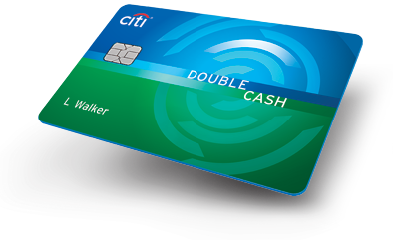
CITI DOUBLE CASH CARD
This a REWARD CARD
0% Intro APR on Balance Transfers and Purchases for 15 months. After that, the variable APR will be 12.99%-22.99%, based on your creditworthiness*
There is a balance transfer fee of either $5 or 3% of the amount of each transfer, whichever is greater
The only card that earns you cash back twice on every purchase with:
1% cash back when you buy
Plus 1% cash back as you pay for those purchases, whether you pay in full or over time*
No Category Restrictions, No Caps, No Enrollments in Rotating Categories
No Annual Fee

Slide 5
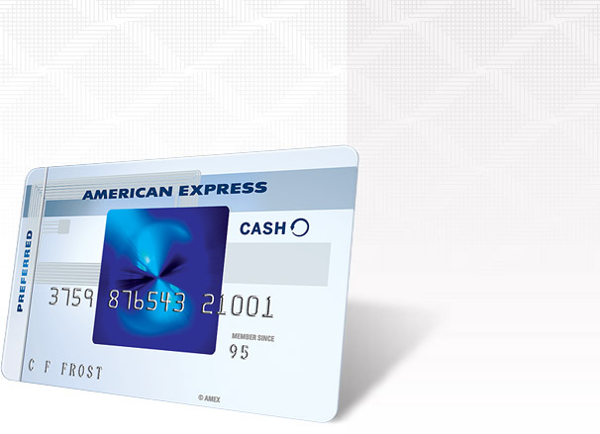
Blue Cash Preferred® Card from American Express
Get $150 back after you spend $1,000 in purchases on your new Card in your first 3 months. You will receive $150 back in the form of a statement credit.
Hassle-free cash back: no enrollment required, the same great reward categories year-round.
Earn Cash Back: 6% US supermarkets up to $6,000 per year in purchases, 3% US gas stations & select US depts, stores, 1% other purchases. Terms and limitations apply.
Cash back is received in the form of Reward Dollars that can be redeemed as a statement credit.
0% intro APR on purchases and balance transfers for 15 months, then a variable rate, currently 12.99% to 21.99%, based on your creditworthiness and other factors.
Terms and limitations apply.
This is CASH BACK credits

Slide 6
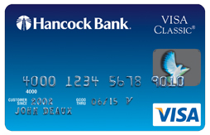
Hancock Bank Visa Classic
This is BALANCE TRANSFER CARD
Signing Promotion
None
Reward Rate
1.00%
Annual Fee
$0
APR, Variable
Purchase: 12.99%, Variable Cash Advance APR: 18.00%, Variable
Intro APR Promotions
Purchase: 0% for 7 mos Transfer: 1.90% for 12 mos

Slide 7
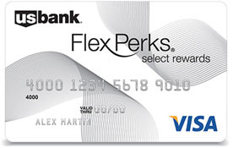
U.S. Bank Flex Perks® Select Rewards Visa® Card
This is TRAVEL CARD
Earn 10,000 bonus Flex Points after you spend $1,000 in Net Purchases within the first four months of account opening.
Earn One Flex Point for every $2 of eligible net purchases charged to your Card.
Earn Triple Flex Points for your charitable donations. Choose from a wide range of eligible local, national and international charities.
Use your Card for everyday purchases like gas and groceries.
No cap on the number of Flex Points you can earn.

Slide 8
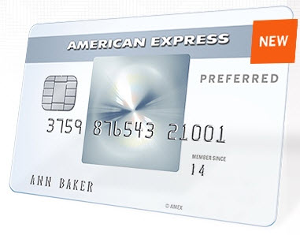
The Amex Every Day® Credit Card from American Express
This Zero Percent Credit Cards
Earn 10,000 Membership Reward® points after you use your new Card to make $1,000 in purchases within the first 3 months.
Earn 20% more points: Make 20 or more purchases with your Card in a billing period and get 20% extra points on those purchases less returns and credits. Terms and limitations apply.
2x points at US supermarkets, on up to $6,000 per year in purchases (then 1x); 1x points on other purchases. Terms and limitations apply.
You can use Membership Rewards® Pay with Points to pay for all or part of your flight, hotel booked and paid in advance, vacation or cruise booking.
No annual fee. Plus, 0% intro APR on purchases and balance transfers for 15 months, then a variable rate, currently 12.99% to 21.99%, based on your creditworthiness and other factors.
Terms and limitations apply.
Visit our credit card partner’s site in order to learn more and securely apply for The Amex Every Day® Credit Card from American Express

Slide 9
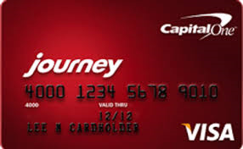
Journey® Student Rewards from Capital One®
This is Student Card
Earn 1% cash back on all purchases, plus a 25% bonus on the cash back you earn each month you pay on time, for a total of 1.25% cash back
There’s no limit to the amount of cash back you can earn, and rewards don't expire
Get access to a higher credit line after making your first 5 monthly payments on time
Pay no annual or foreign transaction fees
Fraud coverage if your card is lost or stolen
Pick the monthly due date that works best for you
Free access to your credit score and learn how everyday decisions can affect your score using Capital One® Credit Tracker

Slide 10
Capital One® Spark® Cash for Business
This is Business Card
Earn 2% cash back on every purchase, every day
Plus, a one-time $500 cash bonus once you spend $4,500 on purchases within the first 3 months
Cash rewards don't expire, and there are no categories to limit where or what you buy
$0 intro annual fee for the first year; $59 after that
Redeem cash rewards anytime, for any amount, even set up automatic redemption
No foreign transaction fees
Earn unlimited cash rewards that don't expire

Slide 11
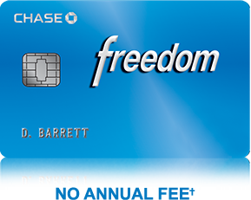
Chase Freedom(R)
This is Low Interest Card
Signing Promotion
Earn a $100 Bonus after you spend $500 on purchases in your first 3 months from account opening
Reward Rate
1.00%* question
Annual Fee
$0
APR, Variable
APR: 13.99%-22.99% (Variable) Cash Advance APR: 24.99%, Variable
Intro APR Promotions
0% for 15 Months on purchases and 0% Intro APR for 15 months on balance transfers

