Slide 1
Product Research
By JESUSINA GYAMFI ABANKWA

Slide 2
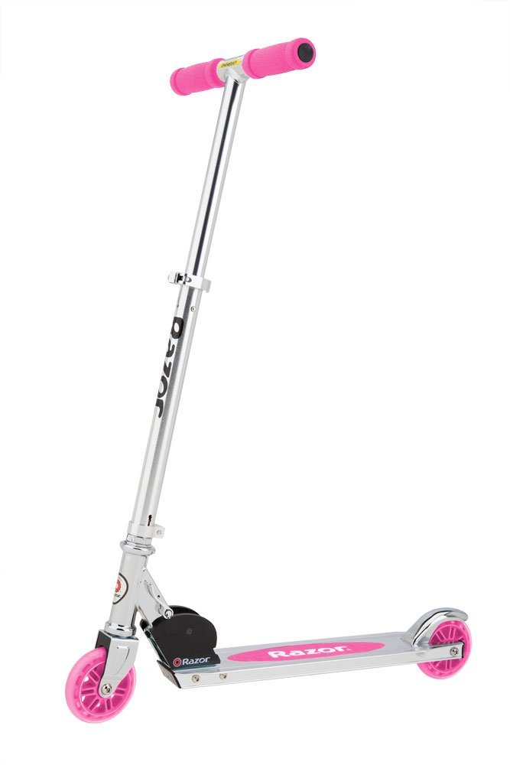
Razor A Kick Scooter
Price Range: 27.99-45.00
Product Specs:
Demand factors:
Kids want scooters
Razor scooters are popular
Supply factors:
Cheap labor from China
Cheap materials
Elasticity:
This is an elastic product: if the price increases, people will buy other brands.

Slide 3
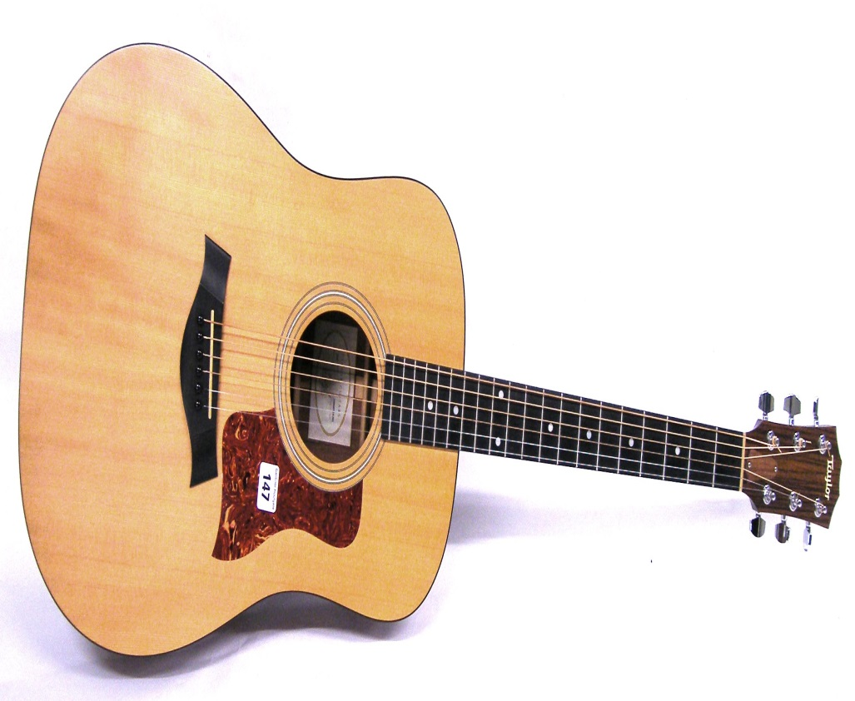
Rogue acoustic guitar
Price Range: 49.99-84.99
Product Specs:
Demand factors
- It produces good tune
-

Slide 4
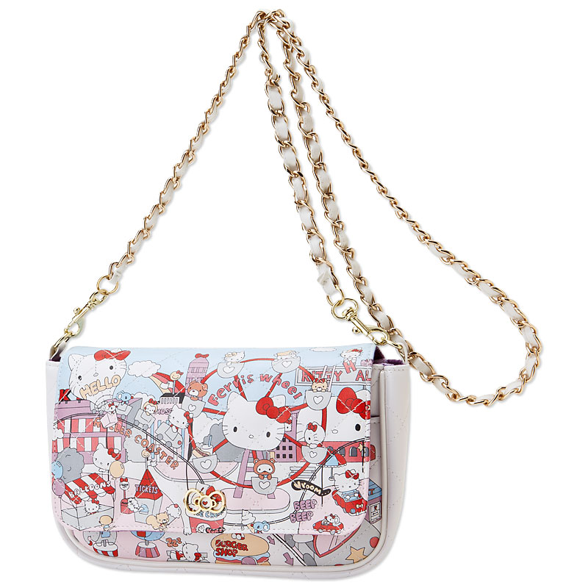
Hello mini kitty shoulder bag
Price Range: 22.00-54.95
Product Specs
Demand factor
- it fancy
- Kids like kitty cats
Supply factor
- cheap materials
- cheap labor from China
Elasticity
_ This is an elastic product: if the price goes up people will buy different brands.

Slide 5
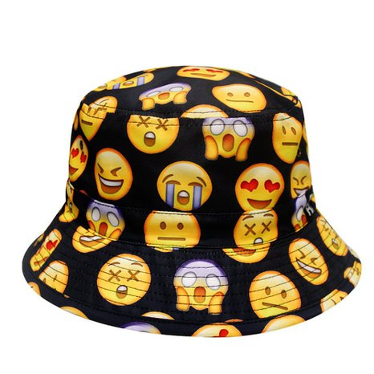
City hunter emoji bucket hat
Price Range: 9.80-14.99
Product Specs:
Demand factor
- emoji’s are cute this days
- guys like bucket hat
Supply factor
- cheap materials
- cheap labor from China
Elasticity
_ If the prices go up, people will buy different brands.

Slide 6
Tan faux leather knee high gladiator sandals
Price Range: 29.99-59.99
Product Specs
Demand factor
- It cool for the summer
- Cheap labor from China
Supply factor

Slide 7
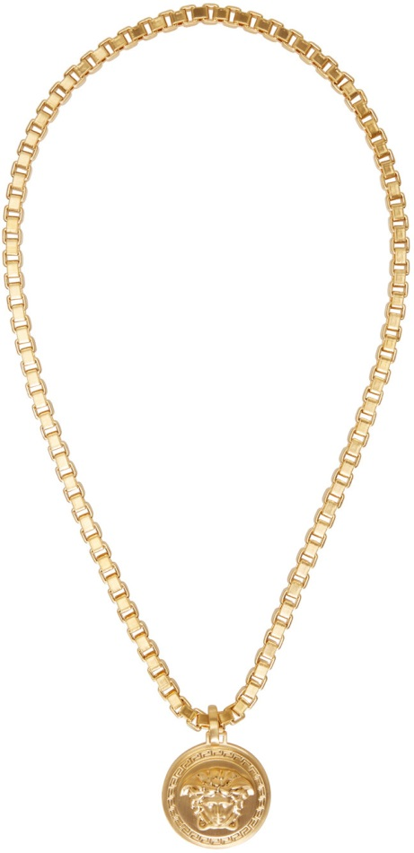

Slide 8
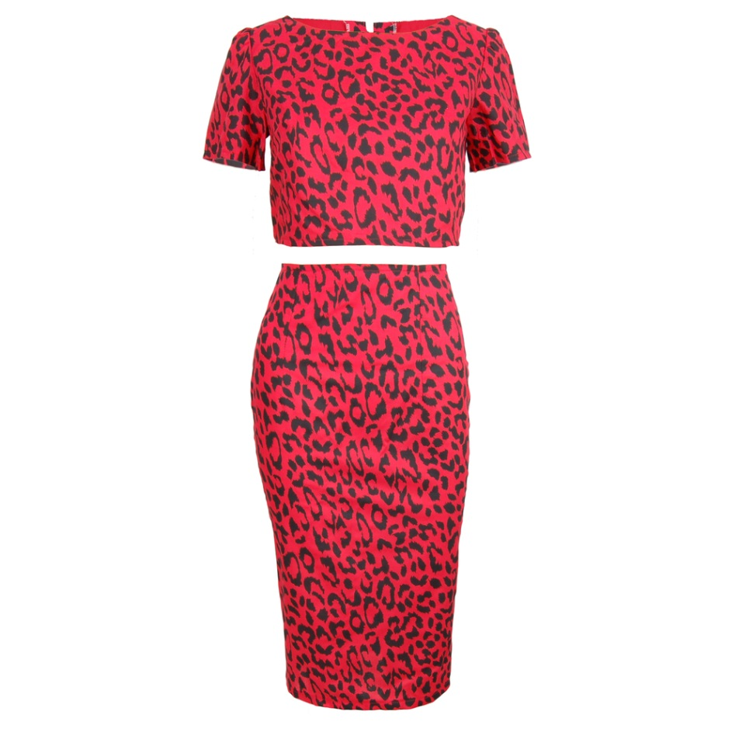

Slide 9
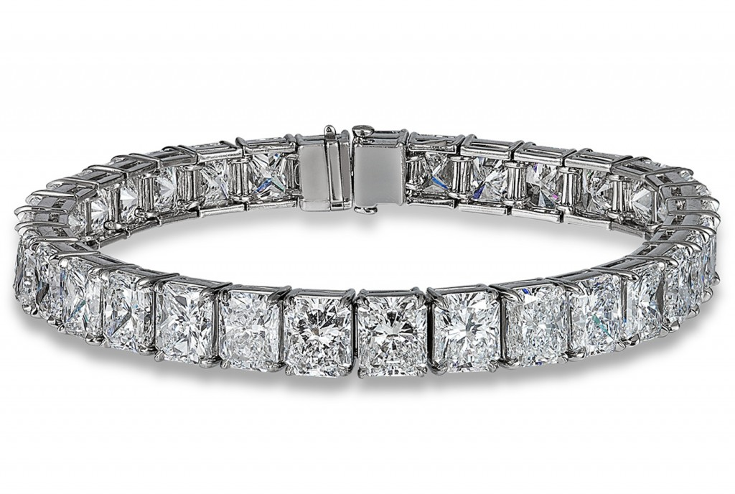

Slide 11
