Slide 1
WISE Buyer versus Conspicuous Consumer By: jesusina gyamfi abankwa

Slide 2
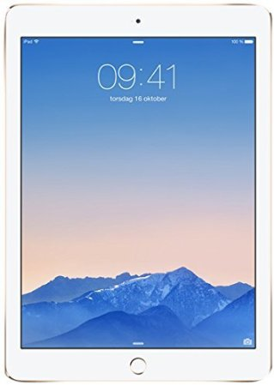
Conspicuous Buy: Ipad Air
Apple iPad Air 2 (64GB)
Price: $554
Why is it conspicuous?
The Ipad is the most wanted tablet in the market
Why is it expensive?
This Ipad has 64gb and is the newest model

Slide 3
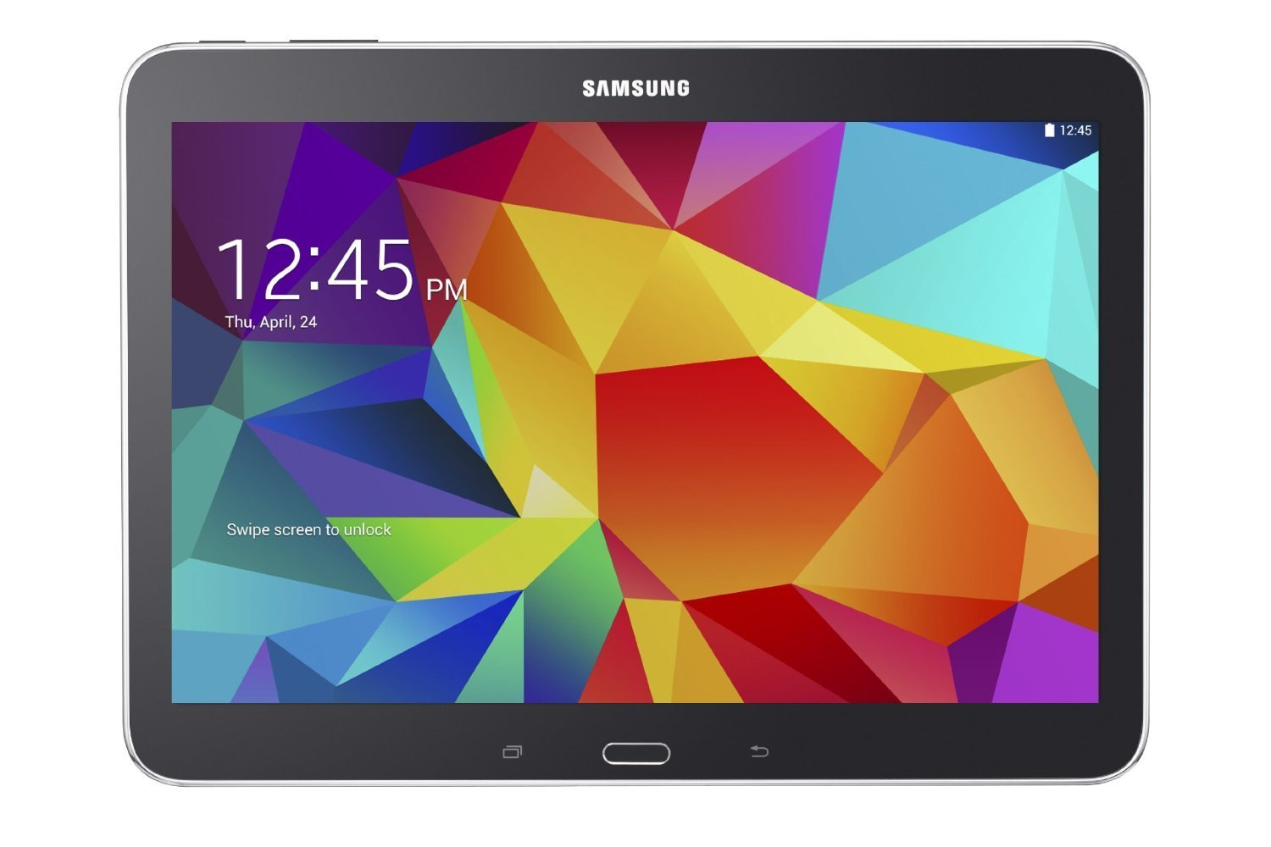
Wise Buy: Samsung Galaxy
Samsung Galaxy Tab 16gb
Price: $244.99
Why is it WISE?
This tablet is cheaper but has similar functions
I sacrifice GB space but I don’t need them

Slide 4
Conspicuous Buy: Silver saucepot
Pure Solid Silver (999‰) Saucepot - 2.5mm - Soy GYT Series
$4,524.00
Why is it conspicuous?
_ People are going to want that.
Why is it expensive?
_ It is made of pure silver

Slide 5
Wise Buy: Emoji Sweatpants
Unisex Emoji Sweatpants joggers pants 3D Star The Last Shot basketball jogging
$13.71 - $25.09
Why is it wise ?
_ It is cheaper and easy to afford

Slide 6
Conspicuous Buy : IPhone App
Armin Heinrich I Am Rich IPhone App
$ 999.99
Why is it conspicuous?
_ People who use IPhones would want to buy it

Slide 7
Wise Buy: Android Phone
Goo phone M3 for just $99.99 1.2GHZ, 5", 512 RAM, 4...
Why is it wise?
_ It is cheap
_ It plays similar function as any other phone

Slide 8
Conspicuous Buy: IPhone 6 plus
Apple iPhone 6 Plus Smartphone 16 GB - Space gray - CDMA2000 1X / GSM / WCDMA (UMTS) / TD-SCDMA
$724 online
Why is it conspicuous?
_ The IPhone 6 plus is the most wanted phone in the market

Slide 9
Wise Buy: Skechers Shoes
Women's Skechers-Air 2.0 Training Shoes
$80.00
Why is it wise?
_ It is cheaper and comfortable

Slide 10
Conspicuous Buy: Jordan Shoes
Jordan AJ XX9 - Men's
$199.99
Why is it conspicuous?
_ Jordan is the most wanted shoes on the market.
Why is it expensive?
_It is the latest Jordan made with valuable materials

Slide 11
Conspicuous Buy: Stainless Steel Bracelet
Tissot PRC 200 Lady Quartz Chronograph White MOP Dial Watch with Stainless Steel Bracelet
$550
Why is it conspicuous?
_ People are in demand for it
Why is it expensive?
_ It is made of steel

Slide 12
Wise Buy: Ladies Watch
Georgia Mini Three-Hand Leather Watch - White
$52.99
Style: ES3267
Why is it wise?
_ It portable and cheap

